Slide 1

C++ & DSA PLACEMENT COURSE
Khaiser Khanam

Slide 2

TIME COMPLEXITY EXPLAINED WITH EXAMPLES

Slide 3

Time Complexity
Time Complexity
Time Complexity
Time Complexity

Slide 4
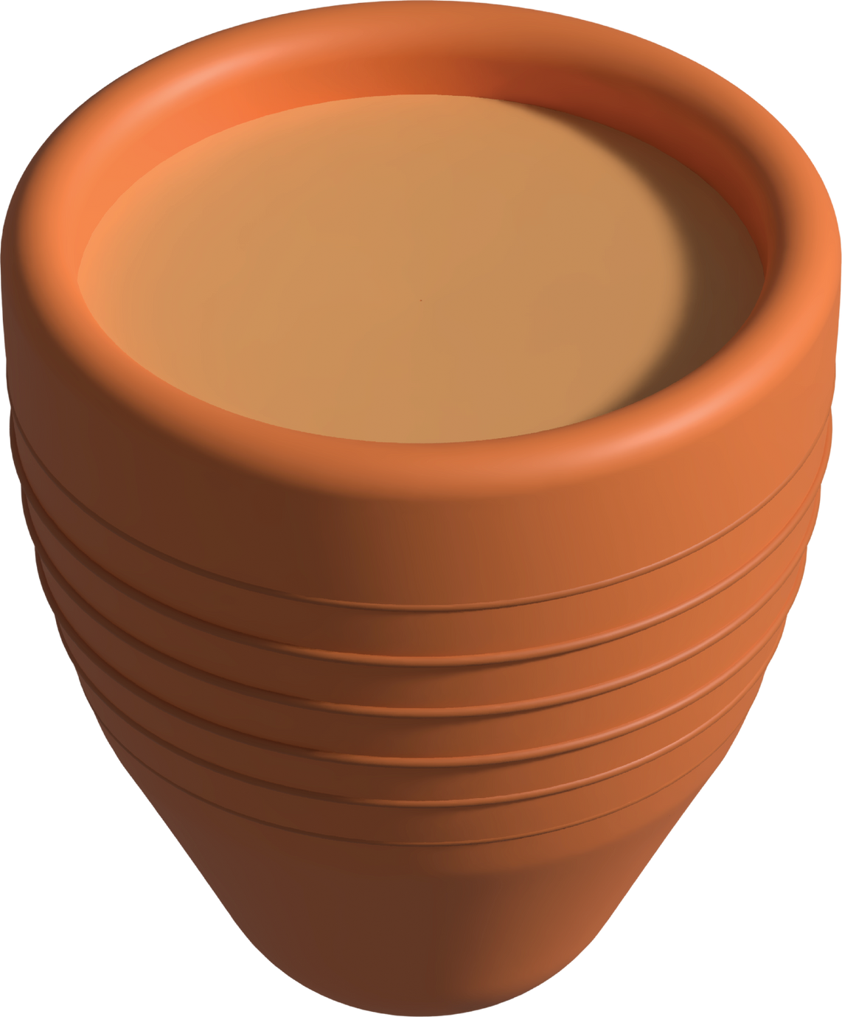

Slide 5





Khanam
Riya
Traditional Tareeke se chai banati hai
Ek Automatic Chai Machine hai
ALGORITHM 1
ALGORITHM 2

Slide 6
Fridge se doodh nikaalna
Gas jalana
Paani ubalna
Chai patti, doodh, adrak, cheeni – sab add karna
Strainer se chhanna
Cup mai daalna
Aur finally… serve karna!
Khanam
Traditional Tareeke se chai banati hai
5 minutes
ALGORITHM 1
15 to 20 minutes

Slide 7

5 minutes
15 to 20 minutes
Input
Algorithm1 directly input pe depend karta hai

Slide 8
Runtime?
Input = number of cups
Runtime = total chai banane ka time
🟢 Runtime = Time taken by algorithm to run

Slide 9
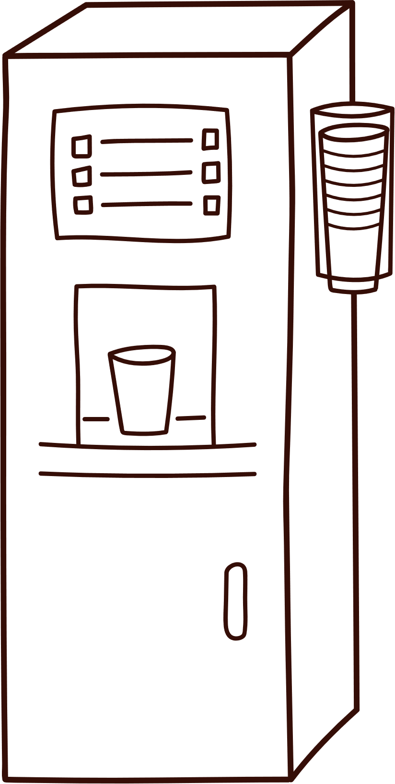

Machine mai bas number of cups daalo
Ek button dabao
1 ho ya 10 cup, machine sirf 5 minute leti hai!
Riya
Ek Automatic Chai Machine hai
Time fix
Constant Time
ALGORITHM 2

Slide 10
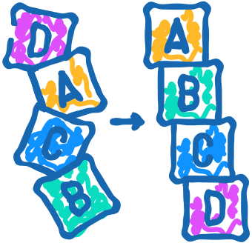

Best Algorithm hai?
Another Algorithm?
Can be performed well?
✅ Input badhne par humara solution kitna slow hota hai?
✅ Ya phir same speed se chalta hai?
Time Complexity

Slide 11
Time Complexity Analysis
Algorithm 1
Traditional Tareeke se chai banati hai
1.Heat water
2.Add tea leaves
3.Add milk
4.Add sugar
5.Pour in cup

Slide 12
Time Complexity Analysis
Algorithm 2
Machine ka working process
User input dena
Button press karna
Machine ka kaam (internal process)

